Slide 1


Hands-on session: explore EUDAT services
Yann Le Franc, PhD
Heinrich Widmann
This work is licensed under the Creative Commons CC-BY 4.0 licence.
Attribution: EUDAT – www.eudat.eu Version 2017-1

Slide 2
The EUDAT service suite
For scientists
Web access, graphical interfaces
APIs

Slide 3
The EUDAT service suite
For scientists
Web access, graphical interfaces
APIs
For data managers, power users
Backend services
APIs or command-line interfaces

Slide 4





The EUDAT service suite
For scientists
Web access, graphical interfaces
APIs
For data managers, power users
Backend services
APIs or command-line interfaces

Slide 5



The EUDAT service suite
For scientists
Web access, graphical interfaces
APIs
For data managers, power users
Backend services
APIs or command-line interfaces

Slide 6




The ideal workflow
STEP 1
Register/Login
STEP 2
STEP 3
STEP 4
STEP 5
Upload files Access shared files
Transfer file to
B2SHARE
Create draft record Upload file from B2DROP Publish record
Visualize Annotation
Search record Access data and metadata
Register/Login Annotate record Retrieve records

Slide 7
The current workflow
STEP 1
Register/Login
STEP 2
STEP 3
STEP 4
STEP 5
Upload files Access shared files
Transfer file to
B2SHARE
Create draft record Upload file from B2DROP
Publish record
Visualize Annotation
Search record Access data and metadata
Register/Login Annotate record Retrieve records

Slide 8
Today’s workflow
STEP 2A
Register/Login
STEP 1
STEP 2B
STEP 3
STEP 4
TRAINING
TRAINING
Register/Login Upload files
Access shared files
Create draft record Upload file from B2DROP
Publish record
Search record Access data and metadata
Register/Login Annotate record Retrieve records

Slide 9
STEP 1 - B2DROP
Register/Login
https://b2drop.eudat.eu

Slide 10
STEP 1 - B2DROP
Register/Login
https://b2drop.eudat.eu

Slide 11
STEP 1 - B2DROP
Main interface

Slide 12
STEP 1 - B2DROP
Main interface

Slide 13
STEP 1 - B2DROP
Main interface

Slide 14
STEP 1 - B2DROP
Main interface

Slide 15
STEP 1 - B2DROP
Main interface

Slide 16
STEP 1 - B2DROP
Main interface

Slide 17
STEP 1 - B2DROP
Transfer to B2SHARE

Slide 18
STEP 1 - B2DROP
Upload file

Slide 19
STEP 1 - B2DROP
Upload file

Slide 20
STEP 1 - B2DROP
Access shared file

Slide 21
STEP 1 - B2DROP
Import shared files by link

Slide 22
STEP 1 - B2DROP
Import shared files by link

Slide 23
STEP 1 - B2DROP
Import shared files by link

Slide 24
STEP 1 - B2DROP
Import shared files by link

Slide 25
STEP 1 - B2DROP
Import shared files by link
https://b2drop.eudat.eu/s/VqXR6UypSUuukWL

Slide 26
STEP 1 - B2DROP
Import shared files by link
https://b2drop.eudat.eu/s/VqXR6UypSUuukWL

Slide 27
STEP 2 - B2SHARE/B2ACCESS
Register/Login
https://trng-b2share.eudat.eu/

Slide 28
STEP 2A - B2ACCESS
Register/Login – 2 options

Slide 29
STEP 2A - B2ACCESS
Register/Login – option 1

Slide 30
STEP 2A - B2ACCESS
Register/Login – option 1

Slide 31
STEP 2A - B2ACCESS
Register/Login – option 1

Slide 32
STEP 2A - B2ACCESS
Register/Login – option 2

Slide 33
STEP 2A - B2ACCESS
Register/Login – option 2

Slide 34
STEP 2A - B2ACCESS
Register/Login

Slide 35
STEP 2B - B2SHARE
Create a new record

Slide 36
STEP 2B - B2SHARE
Create a new record

Slide 37
STEP 2B - B2SHARE
Create a new record

Slide 38
STEP 2B - B2SHARE
Create a new record

Slide 39
STEP 2B - B2SHARE
Upload a file

Slide 40
STEP 2B - B2SHARE
Upload a file from B2DROP

Slide 41
STEP 2B - B2SHARE
Upload a file from B2DROP

Slide 42
STEP 2B - B2SHARE
Upload a file from B2DROP

Slide 43
STEP 2B - B2SHARE
Create a new record

Slide 44
STEP 2B - B2SHARE
Create a new record

Slide 45
STEP 2B - B2SHARE
Create a new record

Slide 46
STEP 2B - B2SHARE
Create a new record

Slide 47
STEP 2B - B2SHARE
Create a new record

Slide 48
STEP 2B - B2SHARE
Publish a record

Slide 49
STEP 2B - B2SHARE
Publish a record

Slide 50
STEP 2B - B2SHARE
Publish a record

Slide 51
STEP 2B - B2SHARE
Publish a record

Slide 52
STEP 2B - B2SHARE
Publish a record

Slide 53
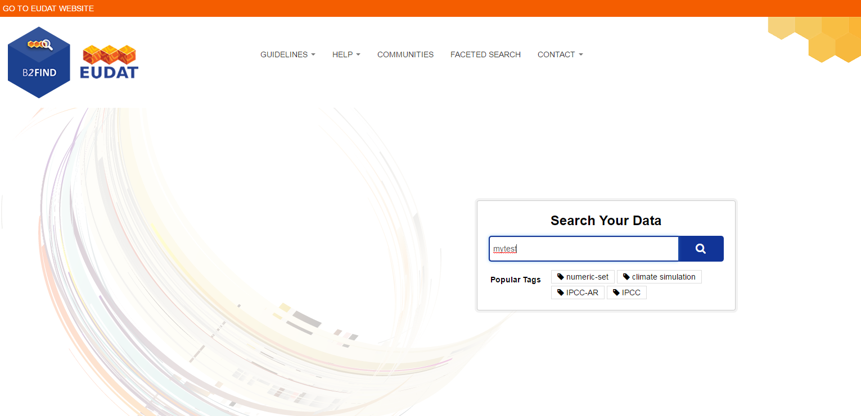
STEP 3 - B2FIND
Front page
http://trng-b2find.eudat.eu

Slide 54
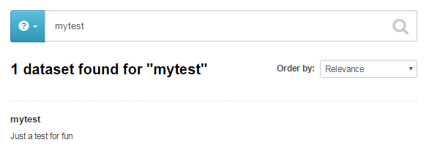
STEP 3 - B2FIND
Freetext search

Slide 55
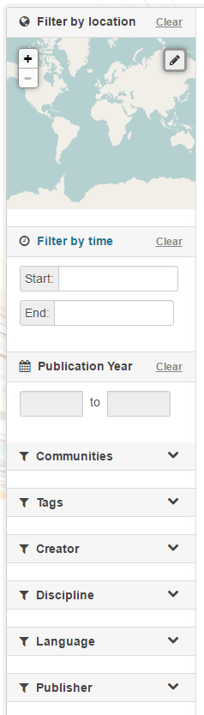
STEP 3 - B2FIND
Facetted Search
B2FIND provides ‘faceted’ search for
Location
Temporal coverage
Publication year
Textual facets:
Communities
Tags
Creator
Discipline
Publisher etc.

Slide 56
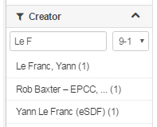
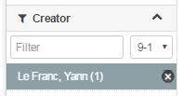
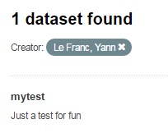
STEP 3 - B2FIND
Search for a creator
1. Select a name
2. Choose a name
3. Enjoy teh result ☺

Slide 57
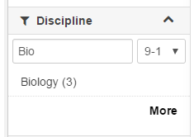
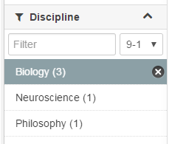
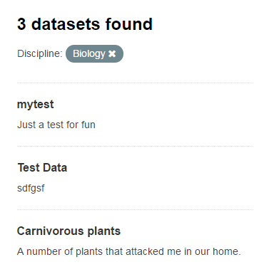
STEP 3 - B2FIND
Search for a discipline
1. Search for ‚Bio…‘
2. Choose ‚Biology (3)
3. Resuliting in 3 datasets

Slide 58
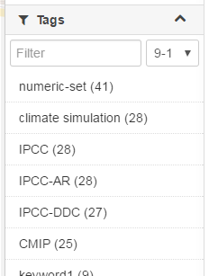
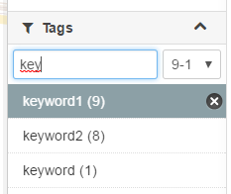
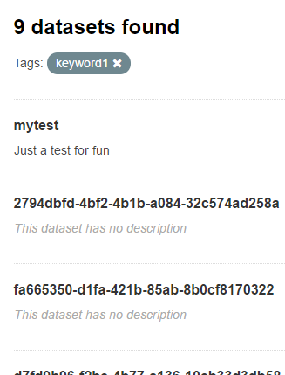
STEP 3 - B2FIND
Search for a keyword (‚tag‘)
1. Search in ‚Tags‘ for ‚key…‘
2. Choose ‚keyword1‘
3. Resulting in 3 datasets

Slide 59
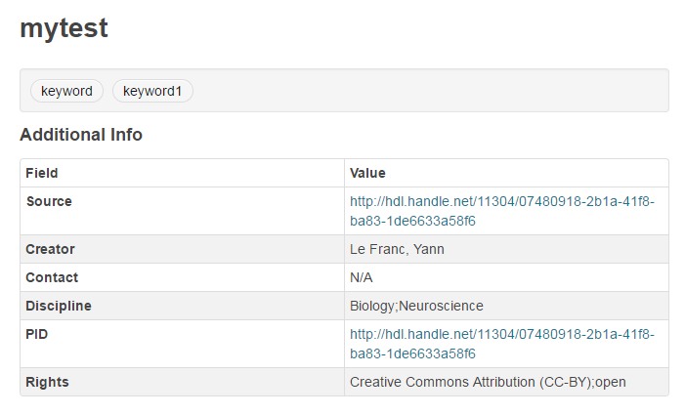
STEP 3 - B2FIND
Dataset Display

Slide 60
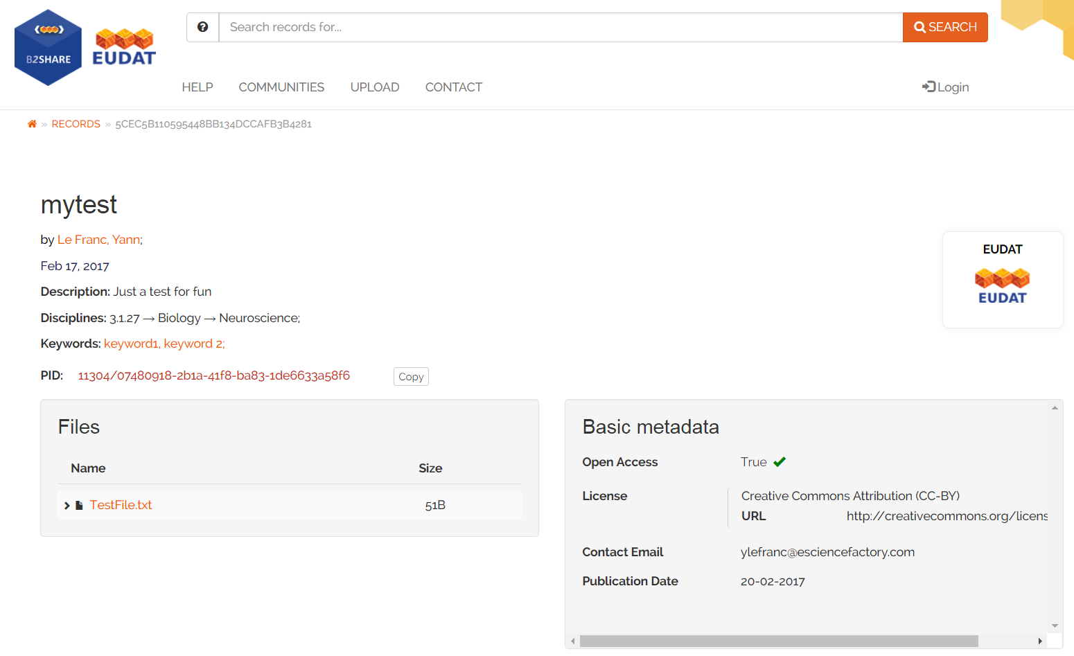
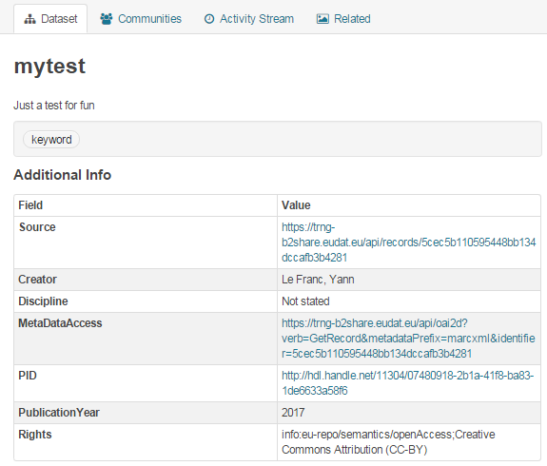
STEP 3 - B2FIND
Data access

Slide 61
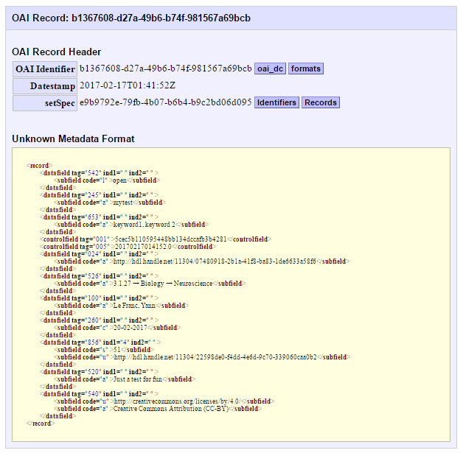
STEP 3 - B2FIND
Metadata access

Slide 62
STEP 3 - B2NOTE
Annotate a record

Slide 63
STEP 3 - B2NOTE
Register/Login

Slide 64
STEP 3 - B2NOTE
Register/Login

Slide 65
STEP 3 - B2NOTE
Annotate a record

Slide 66
STEP 3 - B2NOTE
Annotate a record

Slide 67
STEP 3 - B2NOTE
Annotate a record

Slide 68
STEP 3 - B2NOTE
Annotate a record

Slide 69
STEP 3 - B2NOTE
Annotate a record

Slide 70
STEP 3 - B2NOTE
Annotate a record

Slide 71
STEP 3 - B2NOTE
Annotate a record

Slide 72
STEP 3 - B2NOTE
Annotate a record

Slide 73
STEP 3 - B2NOTE
Retrieve a record

Slide 74
STEP 3 - B2NOTE
Retrieve a record

Slide 75
STEP 3 - B2NOTE
Retrieve a record

Slide 76
STEP 3 - B2NOTE
Retrieve a record

Slide 77
STEP 3 - B2NOTE
Retrieve a record

